Slide 1

OS Lab
Scheduling Algorithms-II
Instructor
Saba Naseem
saba.naseem@nu.edu.pk
4/30/2020
1

Slide 2
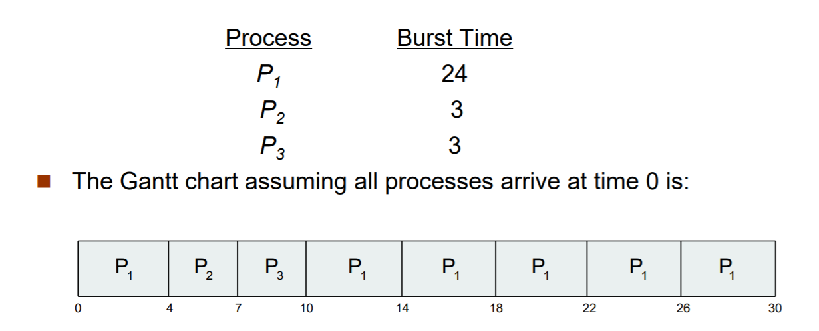
ROUND ROBIN

Slide 3
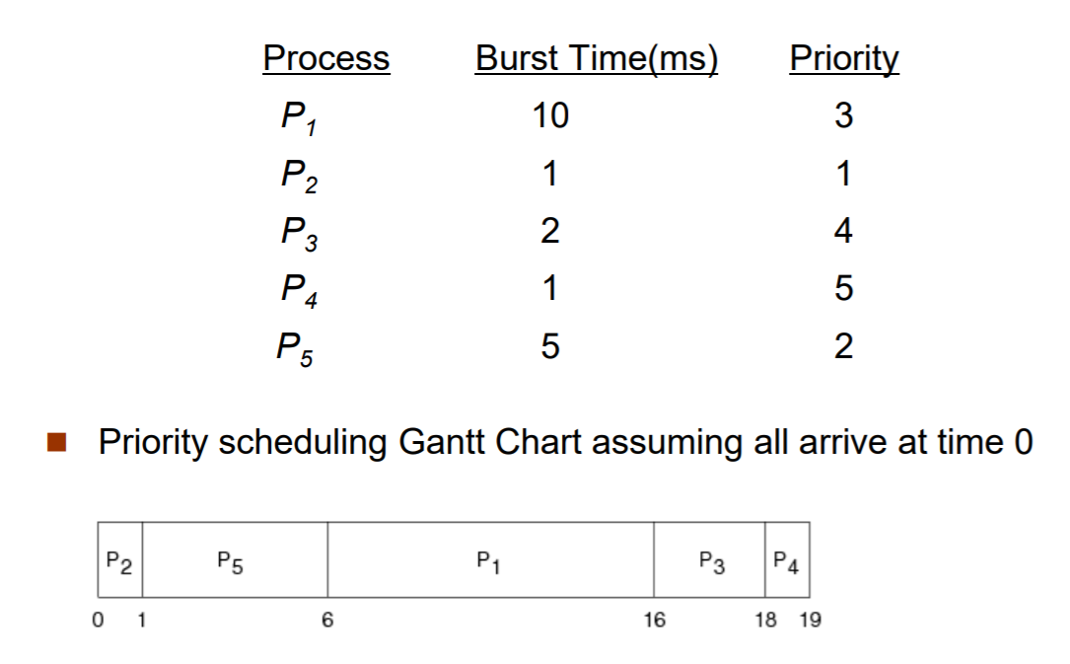
PRIORITY NON PREEMPTIVE

Slide 4
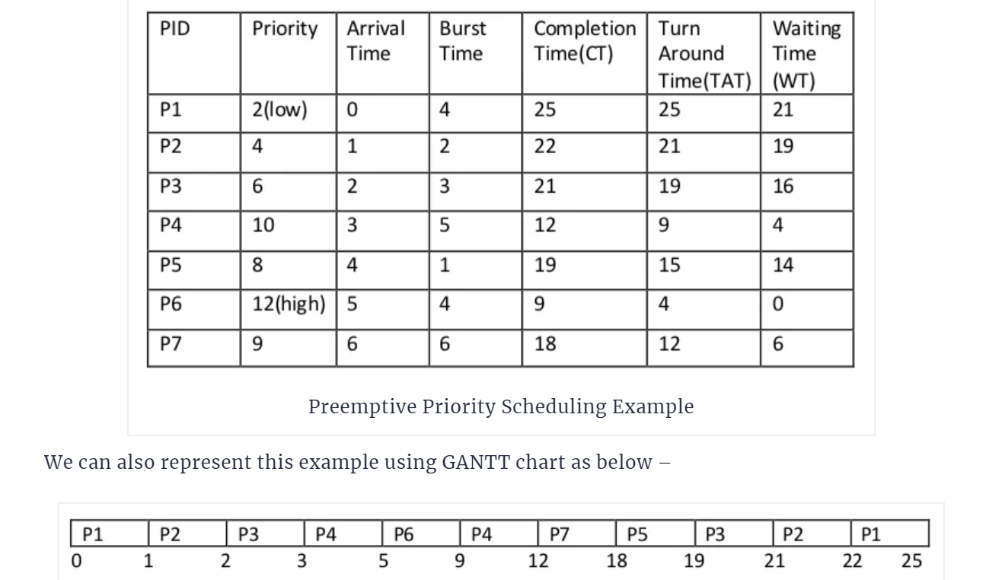
PRIORITY PREEMPTIVE

Slide 5
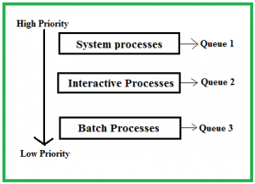
Multilevel Queue Scheduling
A multi-level queue scheduling algorithm partitions the ready queue
into several separate queues. The processes are permanently assigned
to one queue, generally based on some property of the process. Each queue has its own scheduling algorithm.

Slide 6
Scheduling among the queues
Fixed priority preemptive scheduling
Time slicing

Slide 7
Multilevel Feedback Queue
Scheduling
Multilevel feedback queue scheduling, however, allows a process
to move between queues. The idea is to separate processes with
different CPU-burst characteristics. If a process uses too much
CPU time, it will be moved to a lower-priority queue. Similarly, a
process that waits too long in a lower-priority queue may be
moved to a higher-priority queue.

Slide 8
